Slide 1

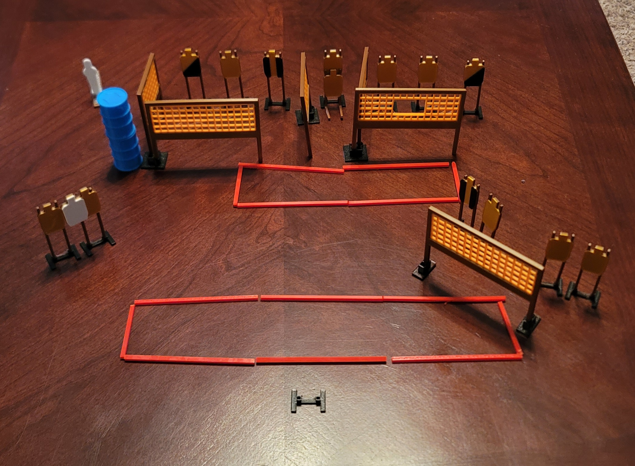
 | Dothan Practical Shooters – USPSA Match Derrick Penwood Course Designer : Eric Henwood Bay: A3
Round Count 29 rounds 14 USPSA 1 colt popper
Equipment List 10 wall feet 12 targets (10 + 2 NS) 2 right diag, 2 tux

Slide 2
Derrick Penwood
Written Stage Briefing
Scoring: Comstock Rounds: 29
Targets: 14 USPSA, 1 steel
Handgun start position: feet on X’s, wrists below belt. Handgun is loaded and holstered.
PCC start position: feet on X’s, stock on belt. Loaded carbine is held with both hands, stock on belt.
Stage Procedure: on the audible start signal, engage targets as they become available from within the shooting area.

